Slide 1
Air Pollution Monitoring
using NodeMcu
Team Member Name:
Burhanuddin Dilshad (Roll No. 07)
Viraj Gholap (Roll No. 10)
Guided By:
Mr. Uday Rote
Department of Information Technology

Slide 2
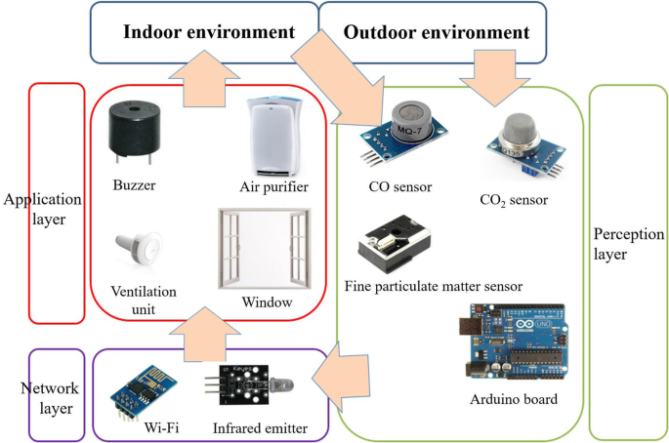
Communication Architecture of Project:

Slide 3
List the Related Protocols:
IEEE 802.11(wi-fi)
HTTP
Bluetooth
ZigBee

Slide 4
Analysis of Protocols
IEEE 802.11 : Wifi Protocol. Provides Internet Connection. Connects Node MCU to Apache Server.
HTTP: Process large amount of data. Transfers multimedia files. E.g. text, images, sound, video, etc.
Bluetooth: 2.4 GHz frequency. Bluetooth is a standardized protocol for sending and receiving data via a 2.4GHz wireless link. It's a secure protocol, and it's perfect for short-range, low-power, low-cost, wireless transmissions between electronic devices.
ZigBee: Zigbee is a standards-based wireless technology developed to enable low-cost, low-power wireless machine-to-machine and internet of things networks.

Slide 5
Wi-Fi And HTTP
Justification of Protocols:
Wifi is used to connect to the server.
HTTP is used to send data from Node MCU to server using POST request.

Slide 6
Benefits :
It can detect compounds that cannot be detected by sight, taste or smell
Shows exactly how your air is doing
Temperature, humidity and pressure are measured
Allows you to take action based on data and knowledge
Helps create the most healthy and comfortable home
An air quality monitor knows more than an air purifier
Commercial air quality monitors are very accurate and easy to operate
Drawbacks: 1. An air quality monitor does not clean the air 2. Air quality monitors require up to 7 days to calibrate
3. Measured VOCs include both harmful and harmless compounds
Benefits and Limitations

Slide 7
Air pollution monitoring is an important application of Internet of Things. In this project we propose an air pollution monitoring system using IoT. The main objective of this model is to monitor and analyze the air pollution from any location.
The use of the MQ135 gas sensor gives the sense of the different types of dangerous gas and Arduino is the heart of this project which controls the entire process. Wi-Fi module connects the whole process to the internet and LCD is used for the visual Output It supports the new technology and effectively supports the healthy life concept. This system has features for people to monitor the amount of pollution on their mobile phones using the application.
Conclusion :

